Slide 1
JIRA & QC INTEGRATION

Slide 2
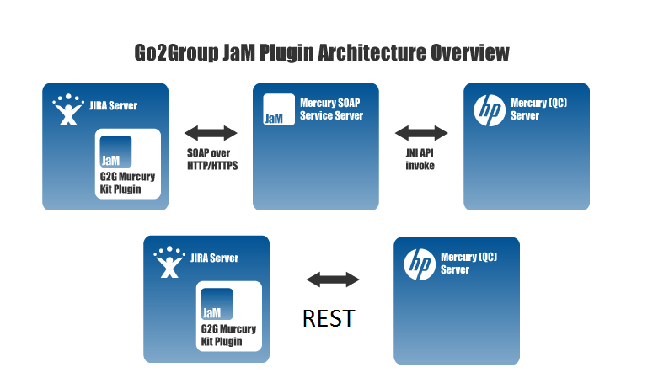
JAM Plug-in Architecture

Slide 3
JIRA & QC INTEGRATION ADVANTAGES
View QC requirements in JIRA.
Synchronize in both directions.
Display QC test cases in JIRA.
The QC and JIRA integration tool, JaM which supports QC 9, 10 and 11 all versions of HP QC and ALM.
it supports defects, test cases and requirement replication and two directional syncs

Slide 4
JAM Plug-in helps boosts efficiency by
Building a tighter collaboration process.
Reducing the amount of down time.
Sharing knowledge between disparate teams.
Merging two different workflows, to helps your teams complete projects on time.
Notes:
- JaM costs $3,000 for unlimited users.
- You can see more information on JaM at https://marketplace.atlassian.com/plugins/com.atlassian.jira.plugin.customfield.crm.

Slide 5
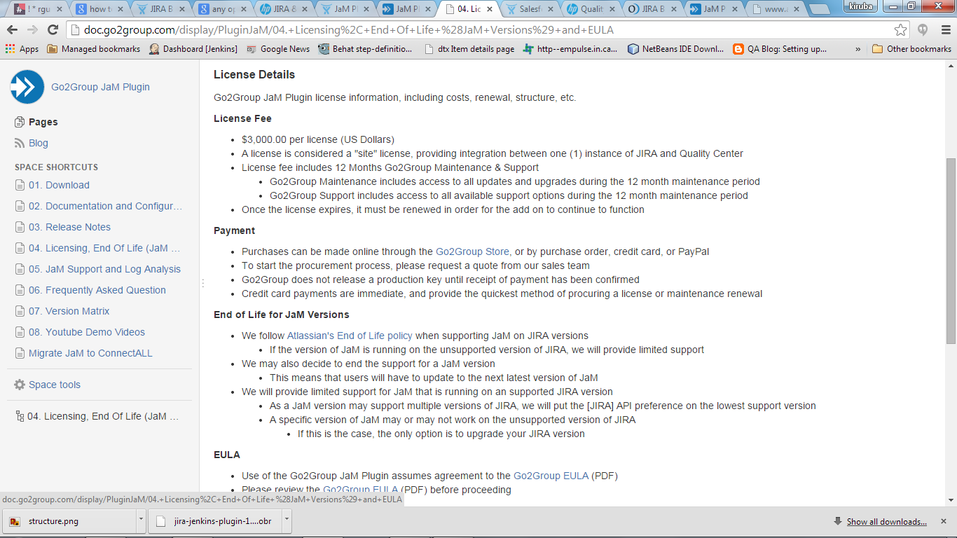
License details

Slide 6
Installation steps
Need to download JaM installer.
Need to download jam jar and install through manage add on in jira ui.
Need to download rest version.

